Slide 1



MS Access
Class VIII
lab 28

Slide 2

Aggregate Query
An aggregate query also known as a totals or summary query is a sum, mass or group particulars

Slide 3
Aggregate Function
S.No | Aggregate Functions & Description
1. | Sum - Adds the field values
2. | Avg - Average of the field values
3. | MinLowest - (minimum) field value
4. | MaxHighest - (maximum) field value
5. | CountCount - of the values (records)
6. | StDevStandard - deviation of the field values including date/time fields
7. | VarVariance - of the field values including date/time

Slide 4
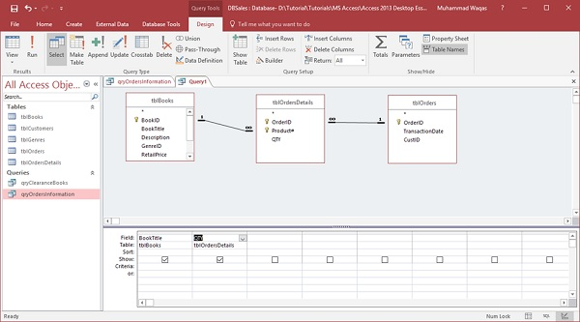
Query Grid

Slide 5
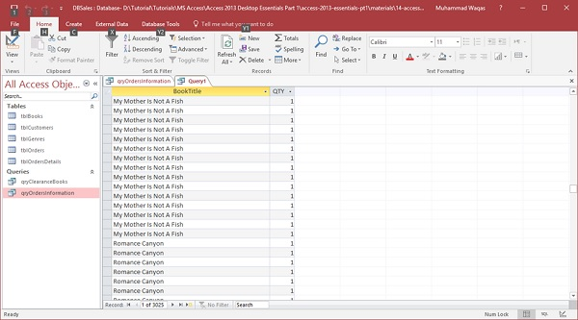
Run the Query

Slide 6
Sigma symbo

Slide 7
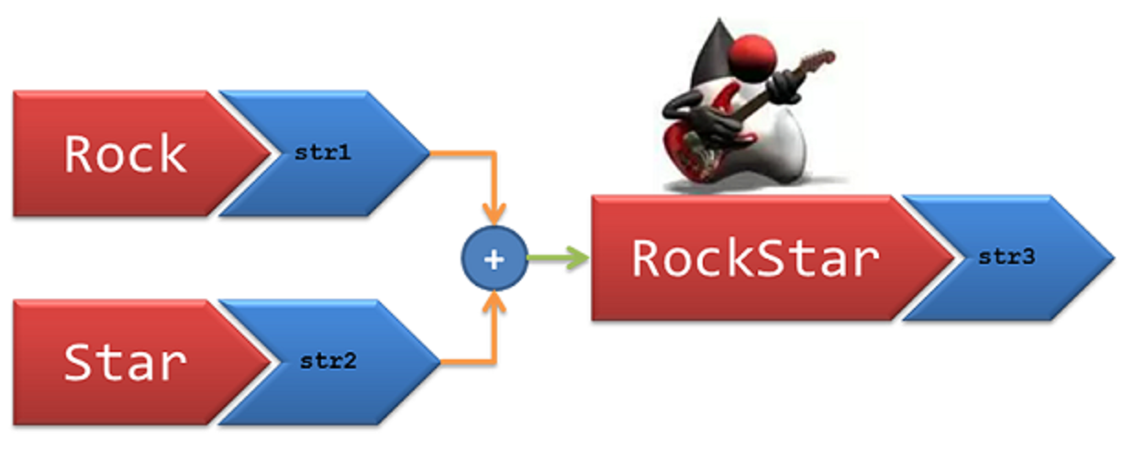
Concatenation in Access
You can display that information together by creating a calculated field that concatenates one or more strings

Slide 8
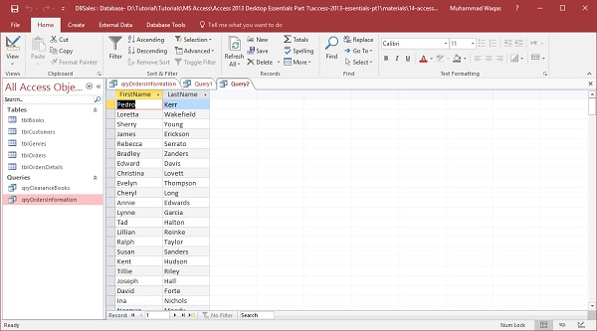
Display Information Together

Slide 9
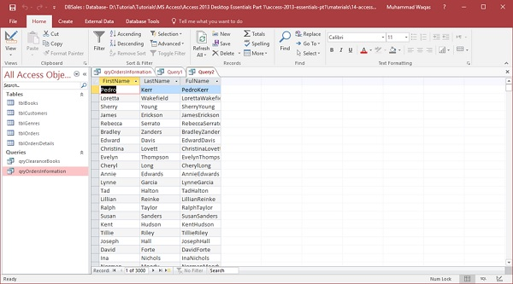
Final View

Slide 10



